Slide 1


REAL ESTATE
by Ahmed Mostafa
01

Slide 2

DATASET OVERVIEW
House price dataset (real estate data)
Number of records: 4600
Number of features: 18
Target variable: House Price
Features:
date
price
bedrooms
bathrooms
sqft_living
sqft_lot
floors
waterfront
view
condition
sqft_above
sqft_basement
yr_built
yr_renovated
street
city
statezip
country
Goal:
Predict house prices and understand the factors affecting them.
02

Slide 3
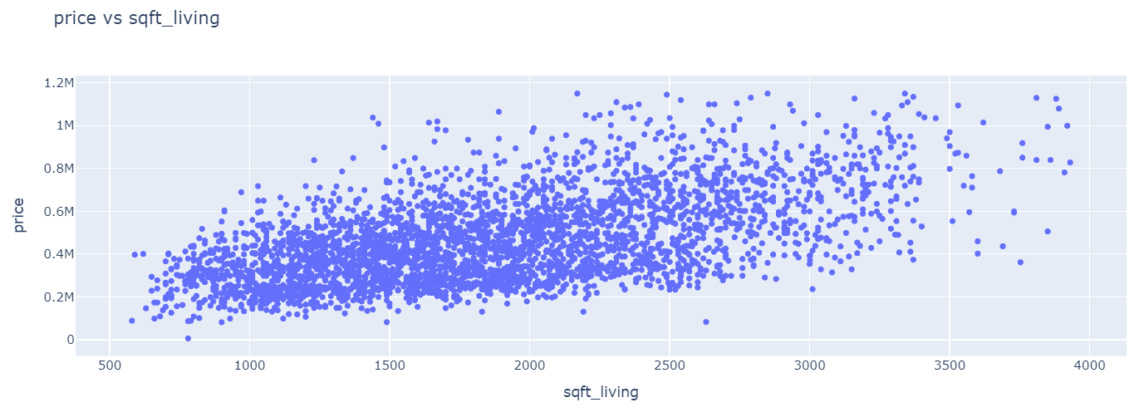
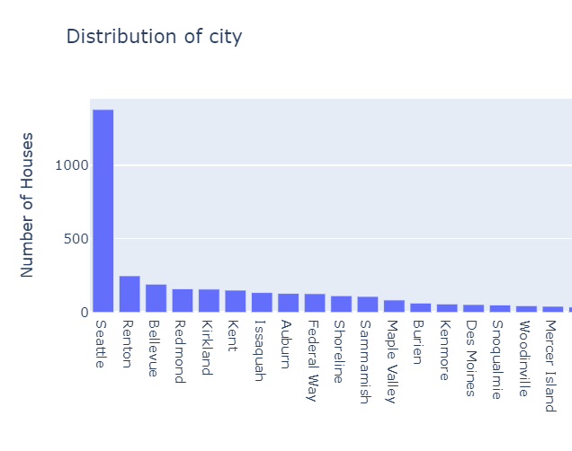
EXPLORATORY DATA ANALYSIS
Analyzed:
Price distribution
Feature relationships
Location impact
Living area vs price
avg price by condition
Distribution of Number of floors
etc
Tools used:
Matplotlib
Seaborn
Plotly
The graph shows that Seattle has the highest number of houses sold in the dataset
03
The graph shows a strong positive relationship between sqft_living and house prices , making sqft_living one of the most important price drivers.

Slide 4
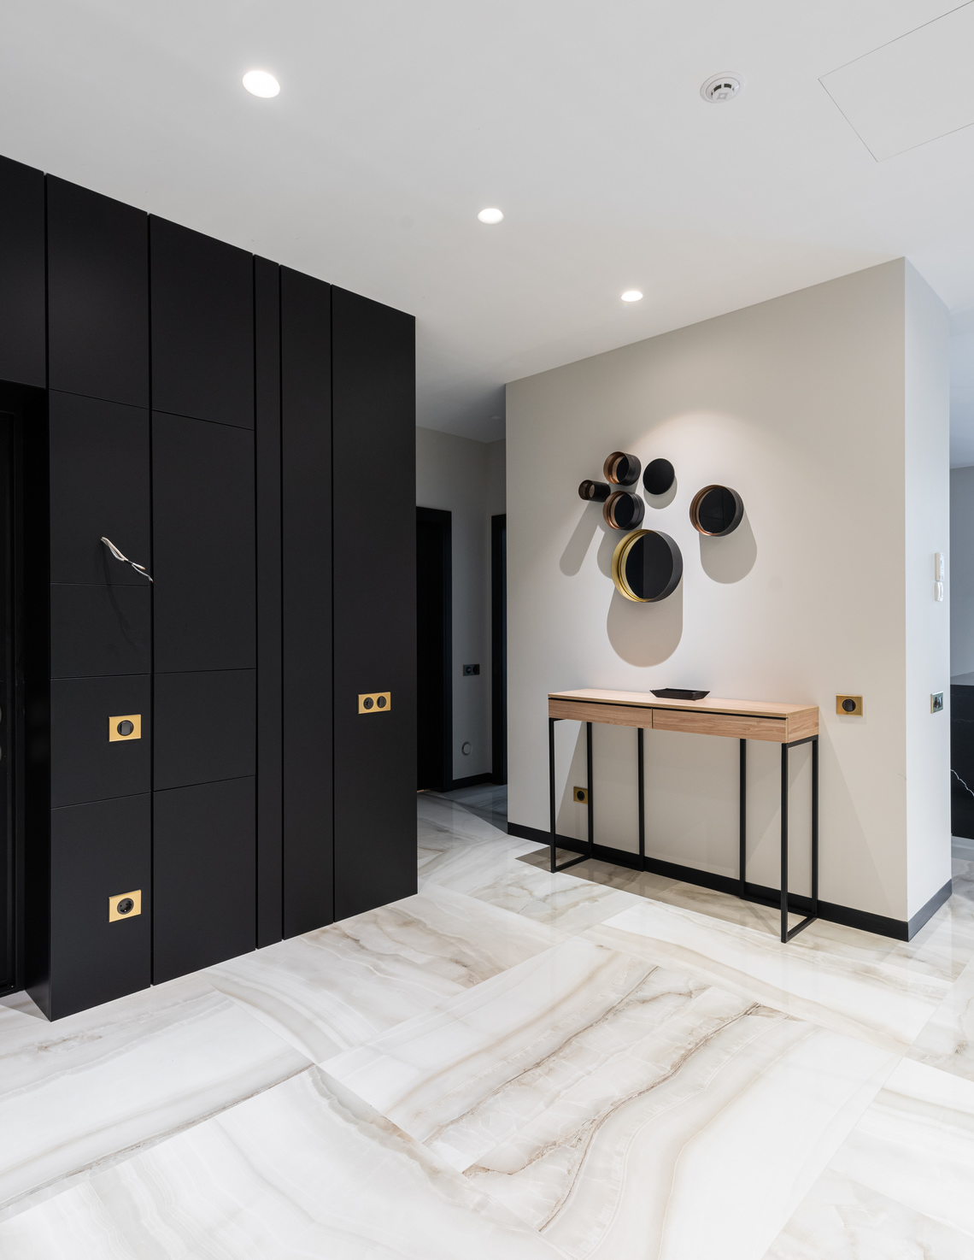
INSIGHTS & RECOMMENDATIONS
Insights:
3-bedroom & 2.5-bathroom houses are the most common and in demand.
Living area is the main price driver:
Larger sqft_living and sqft_above strongly increase house prices.
Premium features:
Waterfront properties and high view ratings significantly raise prices.
Condition over age:
House condition impacts price more than the year built.
Basement & lot size:
Basements have a moderate effect, while lot size has minimal impact.
Location matters:
Seattle: most active market
Clyde Hill & Mercer Island: highest average prices (premium areas)
04

Slide 5
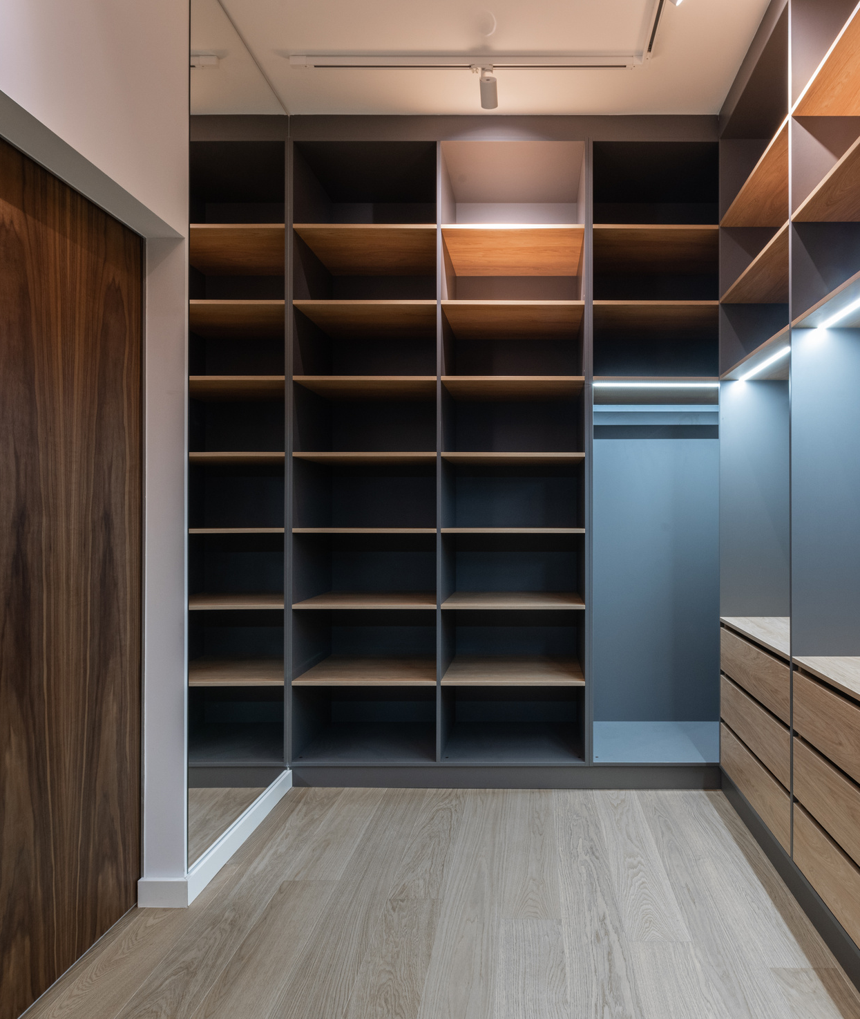
INSIGHTS & RECOMMENDATIONS
Recommendations:
Target high-demand houses:
Focus on 3-bedroom and 2.5-bathroom properties.
Prioritize living area:
Invest in houses with larger sqft_living and sqft_above as the strongest price drivers.
Focus on premium features:
Waterfront properties and high view ratings generate higher returns.
Upgrade condition, not age:
Renovation and good maintenance increase value more than the year built.
Location strategy:
High volume: Seattle
High ROI: Clyde Hill & Mercer Island
Secondary factors:
Basements have moderate impact; lot size has minimal effect.
Overall Strategy:
Invest in houses that combine large living area, good condition, waterfront/view features, and prime locations. Focus on popular configurations for volume and premium neighborhoods for high returns
05

Slide 6
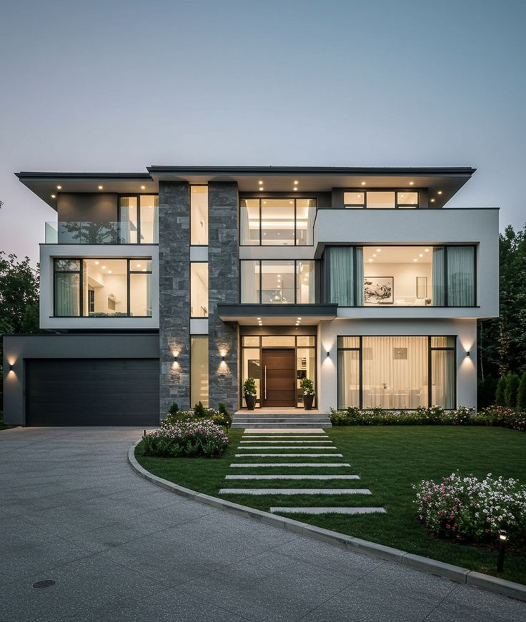
DATA CLEANING & PREPROCESSING
Data Cleaning
Removed data errors and inconsistencies
Corrected data types, especially the date column
Detected and removed outliers
No missing values were found in the dataset
Data Preprocessing
Dropped the country column (all records belong to the United States)
Extracted the sale month from the date and removed the original date column
Created a new feature: House Age (based on year built)
Applied encoding for categorical features
Performed feature scaling to prepare data for modeling
Result: A clean, well-structured dataset optimized for machine learning models
06

Slide 7
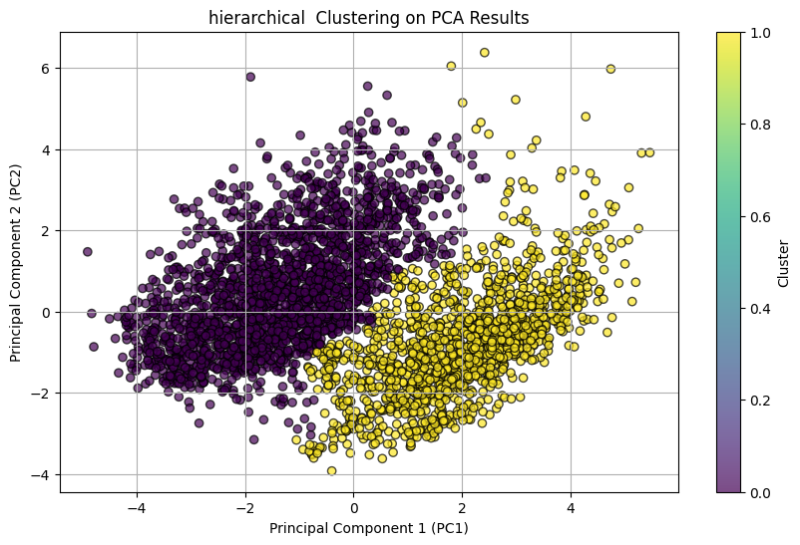
CLUSTERING MODEL
MODEL:
AGGLOMERATIVE HIERARCHICAL CLUSTERING
Divided into two clusters:
Standard Homes
Premium Homes
PURPOSE:
Market segmentation
Better understanding of house categories
07

Slide 8
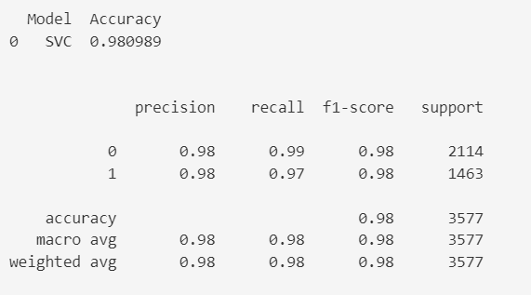
CLASSIFICATION MODEL
MODEL:
SUPPORT VECTOR CLASSIFIER (SVC)
Several classification models were evaluated to predict the cluster category of houses.
Most models achieved very high accuracy, which indicates that the clusters are well separated.
Among all tested models, SVM (Support Vector Machine) achieved the best performance with an accuracy of about 98%.
Although some more complex ensemble models achieved very similar results, SVM was selected as the final model because it provides the best balance between performance and simplicity.
It is less computationally expensive and easier to interpret and maintain, while still achieving excellent and stable results.
The classification report also shows balanced precision and recall for both classes, which indicates that the model performs well for both categories without bias toward any class.
08

Slide 9

REGRESSION MODEL
MODEL:
RIDGE REGRESSION
MAE ≈ 61k RMSE ≈ 87k R² ≈ 82%
Despite trying several advanced models, Ridge Regression achieved the best generalization performance. More complex models such as Gradient Boosting and Random Forest overfitted the data, confirming that model performance is limited by feature quality rather than model capacity
This demonstrates that in this problem, better features are more important than more complex models
09

Slide 10


LLM
API: GROQ
Model: LLaMA-3.3-70B
The LLM answers:
Why was this price predicted?
Is it realistic compared to the market?
10

Slide 11
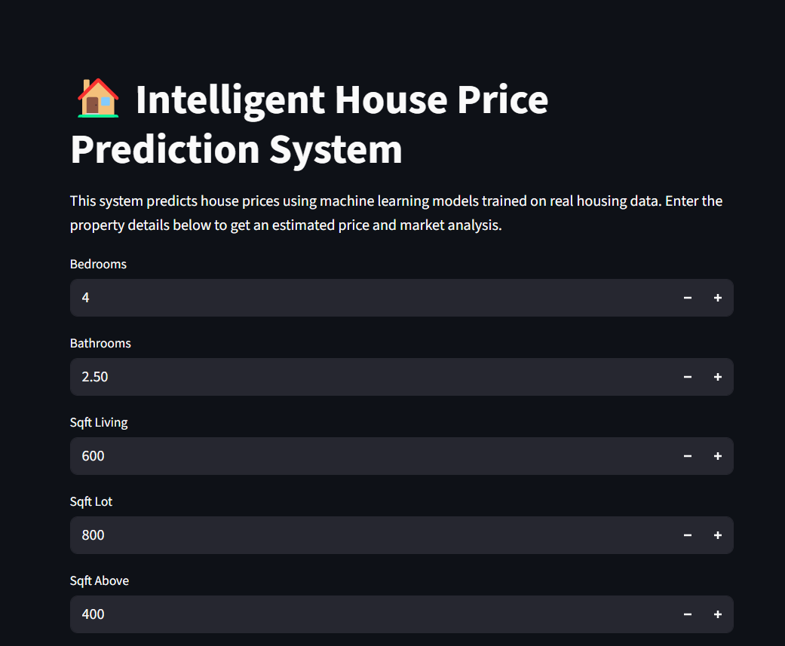
DEPLOYMENT
Streamlit Deployment
Built an interactive Streamlit app
User inputs house features
App outputs:
Predicted price
House category
LLM explanation
Live Demo :
https://housepricepredictionendtoendmlproject-h3k9wasehygz2b8rf4fpv8.streamlit.app
Github :
https://github.com/ahmed75p/House_Price_Prediction_End_to_End_ML_Project/tree/main
Kaggle :
https://www.kaggle.com/code/ahmedmostafa90/house-price-prediction-end-to-end-ml-project
11

Slide 12

CONCLUSION
End-to-end ML project
Strong EDA & business insights
High-performing ML models
AI-powered explanation using LLM
Fully deployed & interactive app
12

Slide 13

THANK YOU
13

